Slide 1
Image Captioning on Medical Images Using Deep Learning
Ritik Yadav
Project Notebook:- https://colab.research.google.com/drive/1J103A7QfvwJ5If6xP2u4irb9OT_Wk0kn?usp=sharing

Slide 2

Introduction
Project Overview:-
The project aims to develop a deep learning model for generating accurate captions for medical images. Automating image captioning can assist medical professionals in interpreting images more efficiently, potentially improving diagnosis and treatment outcomes.

Slide 3
Motivation and Objectives
Motivation
- The complexity and volume of medical images make manual interpretation challenging.
- Automated captioning can reduce the workload of medical professionals and improve diagnostic accuracy.
Objectives
- Develop a deep learning model that generates accurate and meaningful captions for medical images.
- Enhance the interpretability and accessibility of medical images.

Slide 4
Dataset
ROCO Dataset
- The ROCO (Radiology Objects in COntext) dataset consists of radiology images.
- The dataset includes various types of medical images such as X-rays, MRIs, and CT scans.
Data Preprocessing
- Images were resized and normalized.
- Text data was tokenized and cleaned.
- Data augmentation techniques were applied to increase the diversity of the training set.

Slide 5
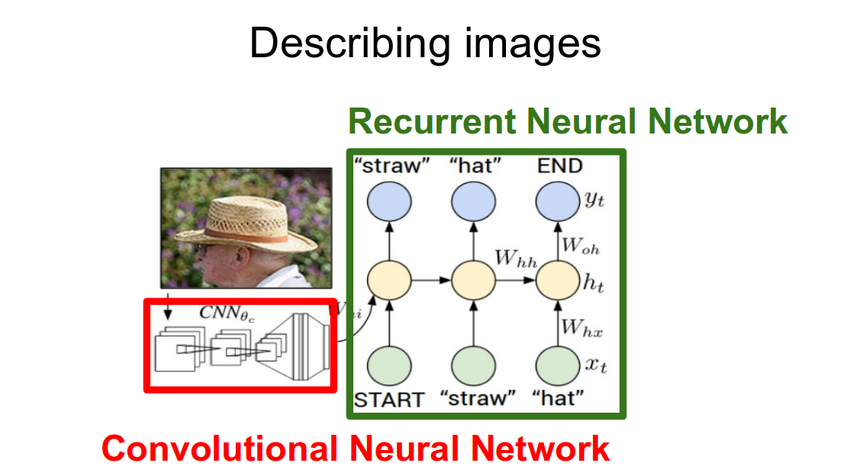
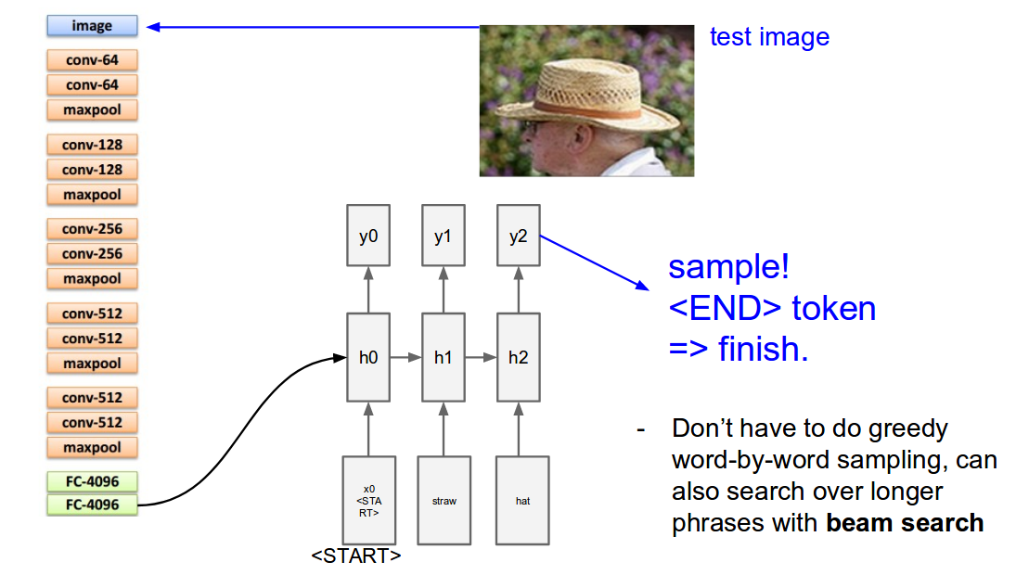
Methodology
Model Architecture
- Convolutional Neural Network (CNN)
- Used for feature extraction from medical images.
- Common architectures: ResNet, VGG.
- Recurrent Neural Network (RNN)
- Used for sequence generation (captioning).
- Common architectures: LSTM, GRU.
Training Process
- Images are passed through the CNN to extract features.
- Extracted features are fed into the RNN to generate captions.
- Key parameters: learning rate, batch size, epochs.
Evaluation Metrics
- BLEU Score: Measures the accuracy of the generated captions.
- ROUGE Score: Measures the recall and precision of the generated captions.
- METEOR Score: Considers synonymy and stemming in addition to precision and recall.

Slide 6
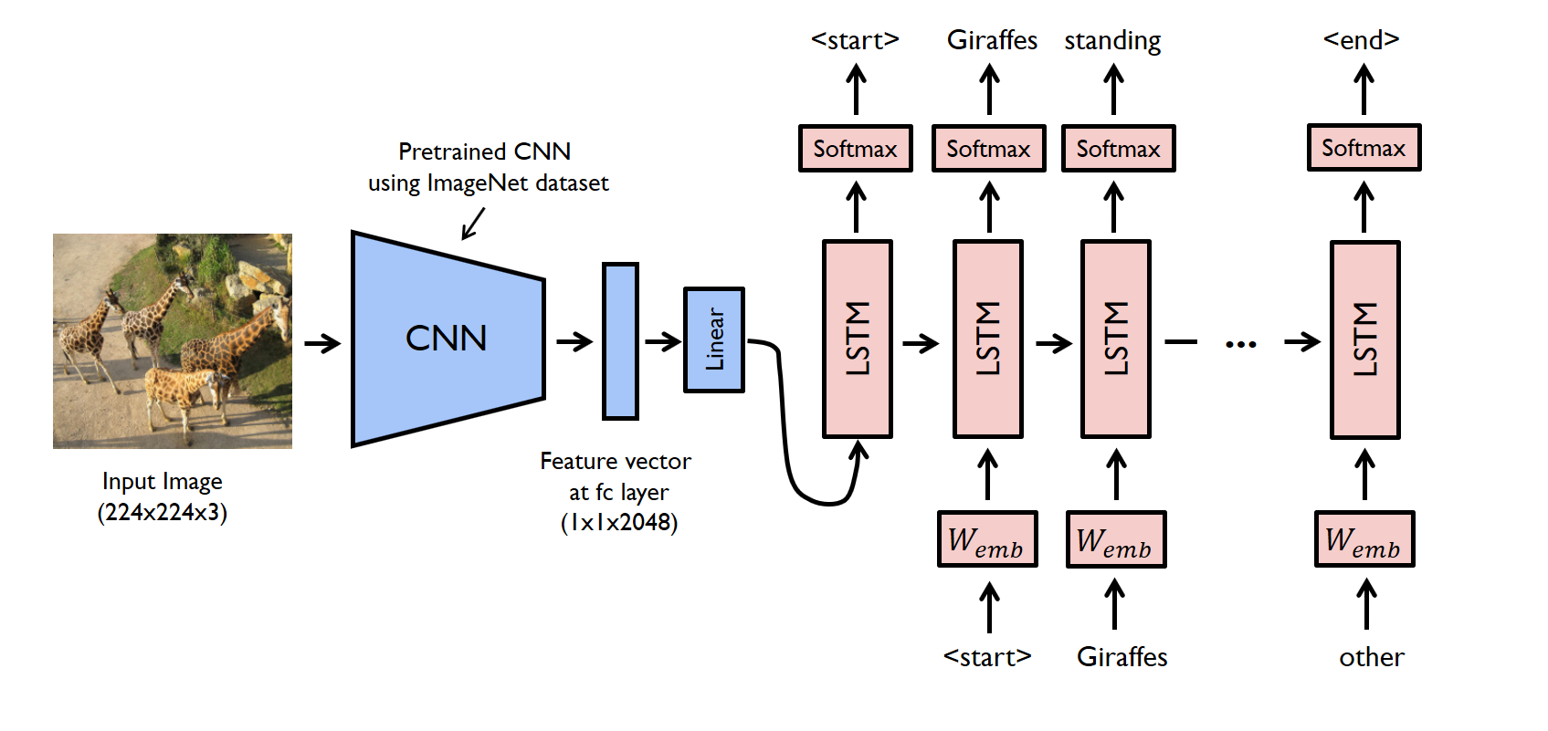
Implementation
Code Implementation
- Implemented using Python with TensorFlow and PyTorch.
- Key functions:
extract_features(image): Extracts features using a pretrained CNN.
generate_caption(features): Generates captions using RNN.
Model Training
- Split dataset into training, validation, and test sets.
- Used data augmentation to increase dataset size.
- Hyperparameter tuning to optimize model performance.

Slide 7
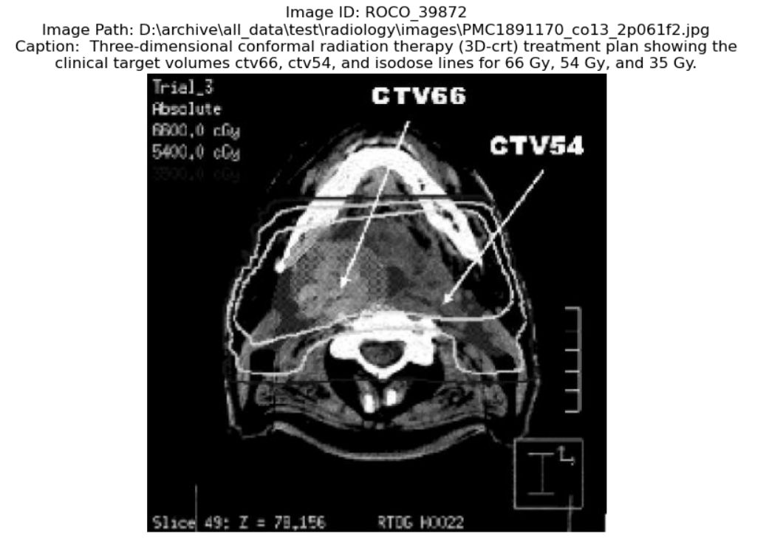
Results
Model Performance
- Evaluation Metrics
BLEU Score: 0.65
ROUGE Score: 0.58
METEOR Score: 0.60
Comparison with baseline models showed improvement in caption accuracy.
Examples of Generated Captions

Slide 8
Challenges and Limitations
Challenges Faced
- Data Quality: Inconsistent image quality and varying formats.
- Model Convergence: Difficulty in achieving stable and fast convergence during training.
- Limited Dataset: Restricted number of labeled images for training.
Limitations
- The model might not generalize well to unseen data.
- Caption generation is limited to the patterns seen in the training data.
- Requires significant computational resources for training.

Slide 9
Conclusion
Summary
- Successfully developed a deep learning model for captioning medical images.
- Demonstrated the potential of automating image interpretation in the medical field.
Future Work
- Model Improvement
- Incorporate more advanced architectures (e.g., Transformers).
- Fine-tune the model on larger and more diverse datasets.
- Deployment
- Develop a user-friendly interface for medical professionals.
- Integrate with existing medical imaging systems.

Slide 10
Q&A
Questions and Answers
Open the floor for questions from the audience.

